Slide 1
A Concrete Truth: predicting concrete strength and carbon footprint
Daniel Freese & Konrad Genser

Slide 2
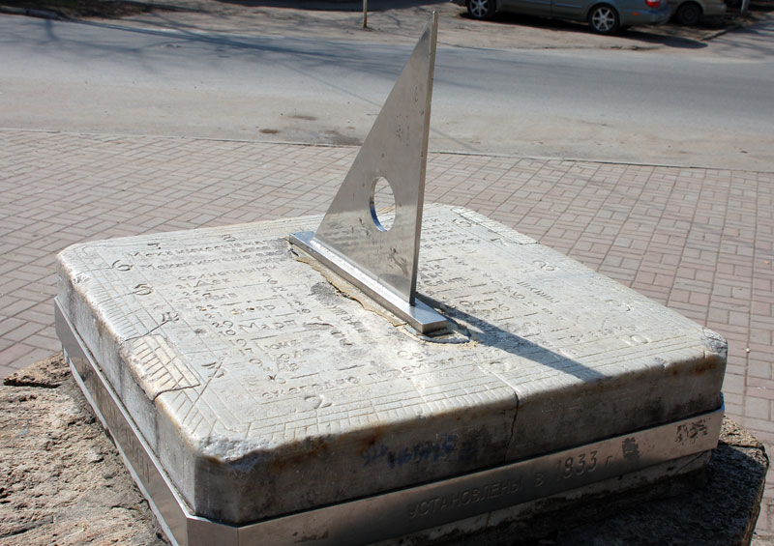
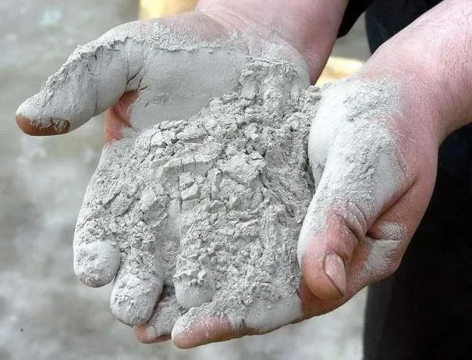

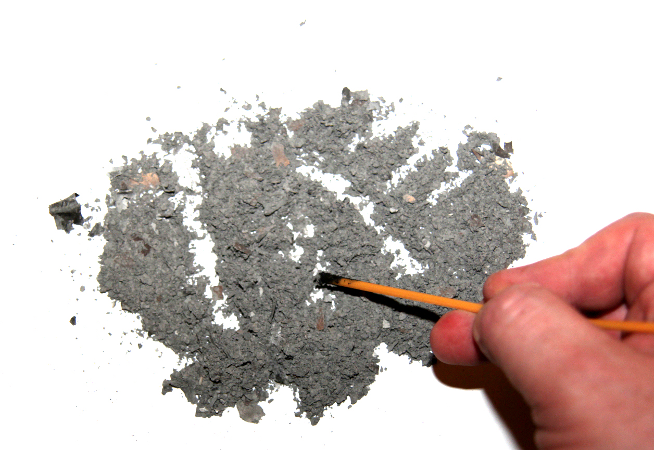

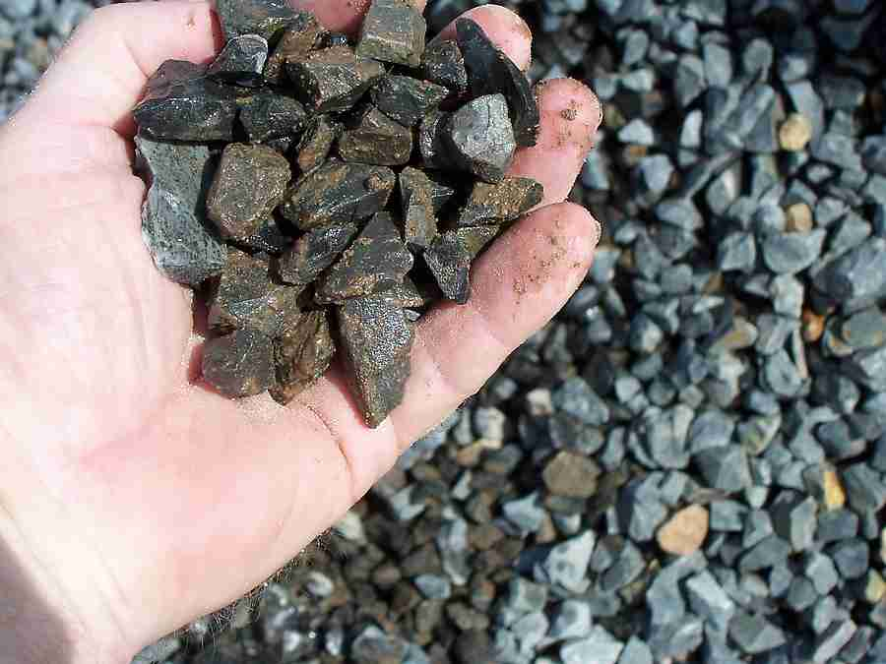
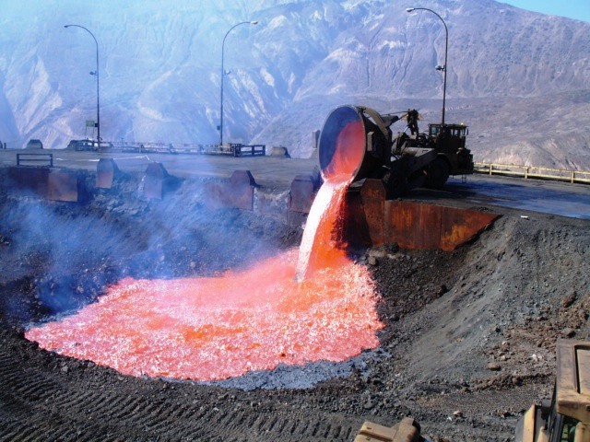

Concrete Data (from Kaggle)
Wait to Cure
Cement
Fine Aggregate
(Sand)
Ash
Industrial Waste
Filler
Superplasticizer
(Optional)
Water
Coarse Aggregate
Slag

Slide 3
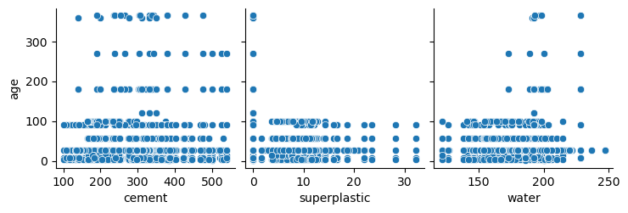
Outliers (age)

Slide 4
Different Models
Linear – plain and simple, baseline
Random Forest – Robust and usually works for interpolative
XGBoost – Random forest but better
Histogram-based Gradient Boosting Regression Tree – also robust
Neural Networks – Potential and seems like fun

Slide 6
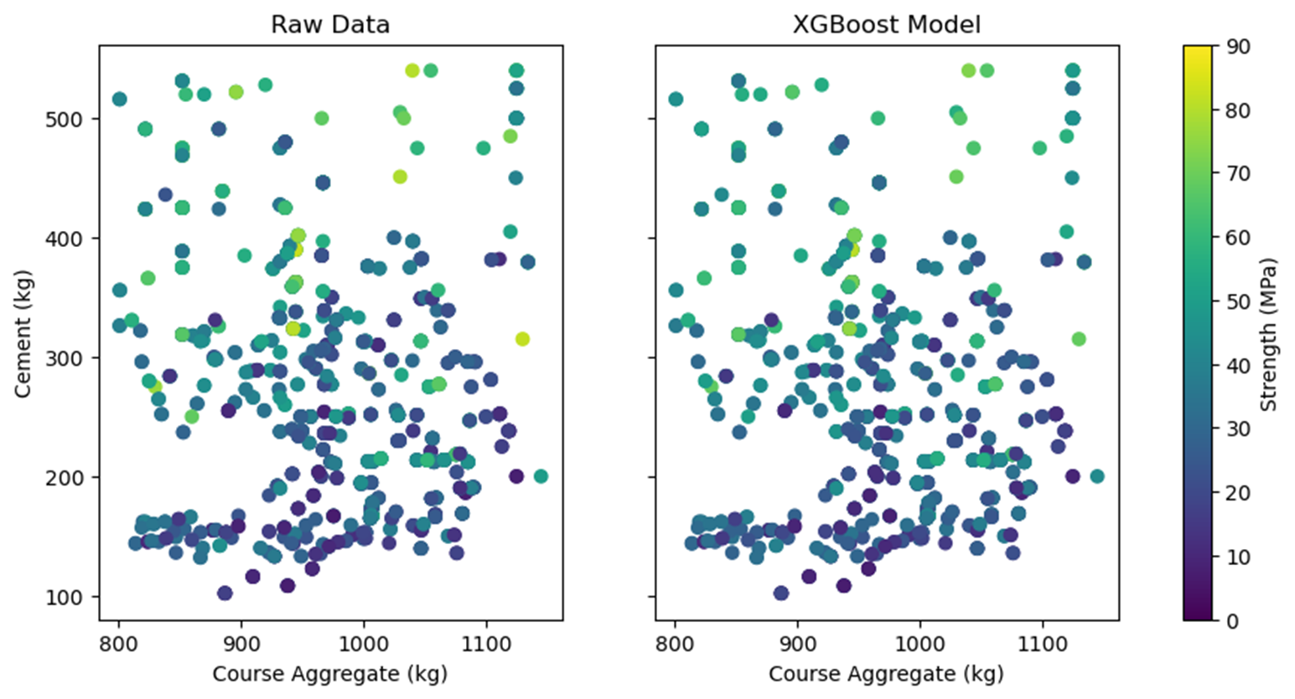
XGBoost Model comparison
Final Mean Squared Error: 18.9 (Mpa²)

Slide 7
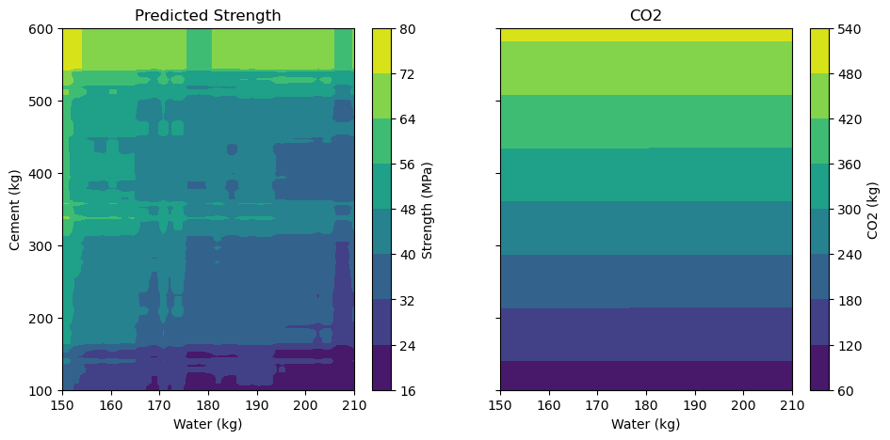
Carbon vs strength

Slide 8
Conclusion (if we had more time)
We have a model with decent accuracy within the parameters given
Analysis on ash and slag
More training time
Build an inverse function that take strength, carbon footprint, and price and gives ingredients
Make a million dollar concrete startup based off a dataset on Kaggle

